Slide 1
Build Alexa Skills in the Microsoft world
Marco Minerva
Microsoft MVP Windows Development
https://about.me/marcominerva
Twitter: @marcominerva
Matteo Pagani
Windows AppConsult Engineer @ Microsoft
matteo.pagani@microsoft.com
Twitter: @qmatteoq

Slide 2
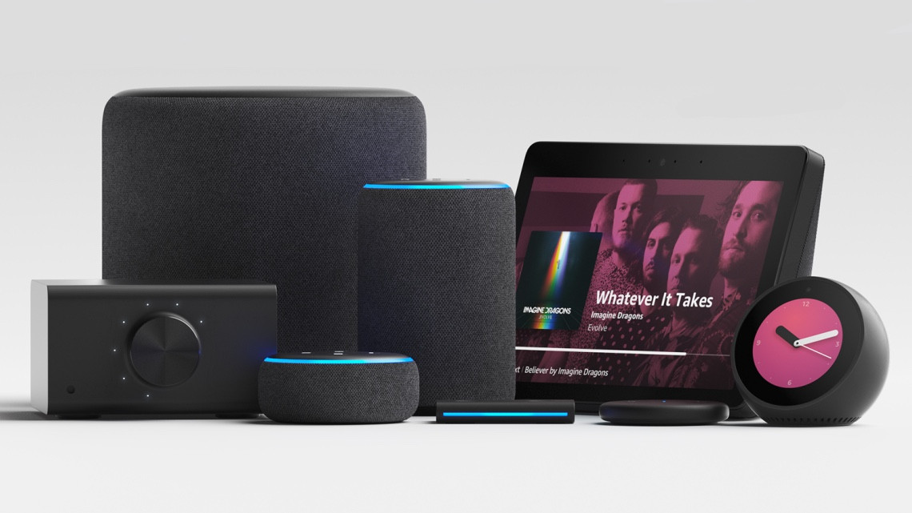

Slide 3
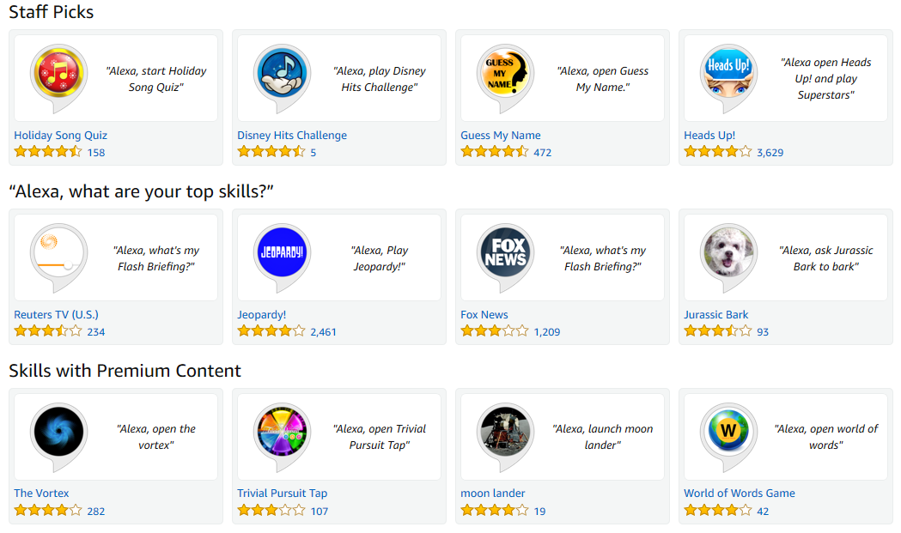
Alexa skills = apps for Alexa

Slide 4







Alexa Skill Kit (ASK)
Request
Response
Speech Recognition
Natural Language Understanding
Text To Speech
Your backend

Slide 5
The interaction model
It defines the ways the user can interact with your skill
Key concepts
Invocation name: “Alexa, open BBC World”
Intent: “Alexa, open BBC World and tell me the latest news”
Slot: “Alexa, open BBC World and tell me the latest news about technology”
It can be defined using the Alexa Developer Portal (web interface) or a CLI
The CLI is available also as an official extension for Visual Studio Code

Slide 6
The backend
Whenever a skill is invoked, Alexa sends a HTTP POST to an endpoint with the request as JSON payload in the body
This means that your backend can be agnostic:
Any framework
Any programming language
Any backend technology
HTTPS only
Amazon provides SDKs for NodeJS, Python and Java
Amazon offers built-in support in AWS Lambda
… but we’re Microsoft developers!

Slide 7



Visual Studio + Alexa.NET + Azure Functions
+
+
.NET

Slide 8
My first Alexa skill
Demo

Slide 9
Are we ready to submit?
A skill must pass a certification process in order to be available in the Alexa Store
Two kind of tests:
Automatic (validation, functional tests, technical tests)
Manual (policies, metadata, etc.)

Slide 10
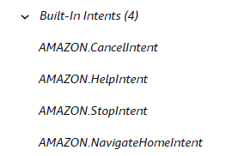
Built-in intents
Alexa supports a set of built-in commands, like Stop, Help, Cancel, which you must implement
You must handle the launch request
You must handle the session ended request

Slide 11
Security validation
You must verify that the request is indeed coming from the Alexa servers
Two requirements to satisfy:
Validate the signature, using one of the headers of the request
Validate the timestamp

Slide 12
Welcome Alexa Skill Template for VS!
A template for Visual Studio to create an Alexa Skill with Azure Functions as a backend
It includes support to:
Built-in intents
Security validation
Multiple languages

Slide 13
Alexa Skill Template
Demo

Slide 14
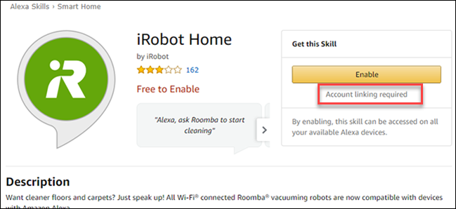
Account linking
In some cases, you need to identify your user before performing an operation
Alexa supports Account Linking, which is triggered when you enable the skill
Account Linking is based on OAuth 2.0
Your skill receives the access token required to perform operations against the service

Slide 15
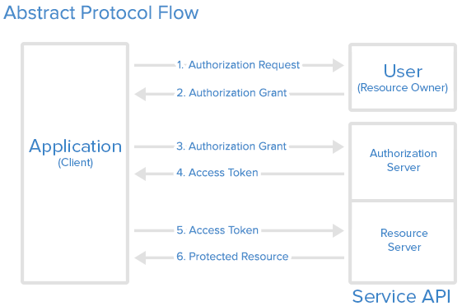
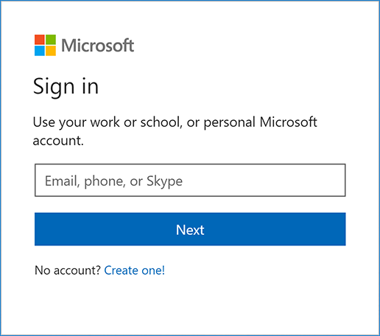




The OAuth 2.0 flow

Slide 16
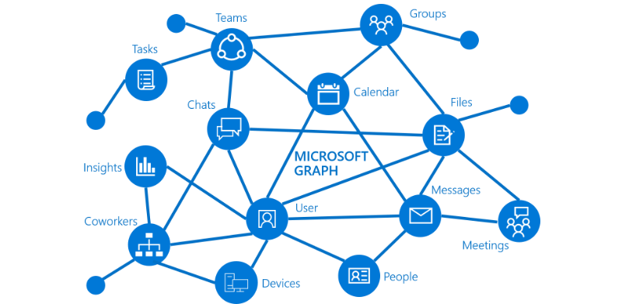
Alexa + Azure AD authentication = Microsoft Graph

Slide 17
Account linking with Azure AD
Demo

Slide 18
Resources
Alexa Developer Portal https://developer.amazon.com/alexa
Alexa.NET https://github.com/timheuer/alexa-skills-dotnet
Alexa Skills Project Template https://marketplace.visualstudio.com/items?itemName=MarcoMinerva.AlexaSkillProjectTemplate
Alexa CLI for Visual Studio Code https://marketplace.visualstudio.com/items?itemName=ask-toolkit.alexa-skills-kit-toolkit
Ngrok: https://ngrok.com/
Tutorials https://aka.ms/appconsultblog

Slide 19


Thanks! Questions?
Marco Minerva Microsoft MVP Windows Development https://about.me/marcominerva Twitter: @marcominerva | Matteo Pagani Windows AppConsult Engineer @ Microsoft matteo.pagani@microsoft.com Twitter: @qmatteoq

